Slide 1

Предварителна обработка на данни
Почистване, опознаване и обяснителни характеристики
23 Октомври 2021

Slide 2



Накратко за нас
SCHWARZ IT BULGARIA
Пенчо Добрев
Ръководител отдел
BI, AI & Data Services
Слав Йолов
Data Scientist
Artificial Intelligence
BI, AI & Data Services
Недялко Йорданов
Data Scientist
Artificial Intelligence
BI, AI & Data Services

Slide 3





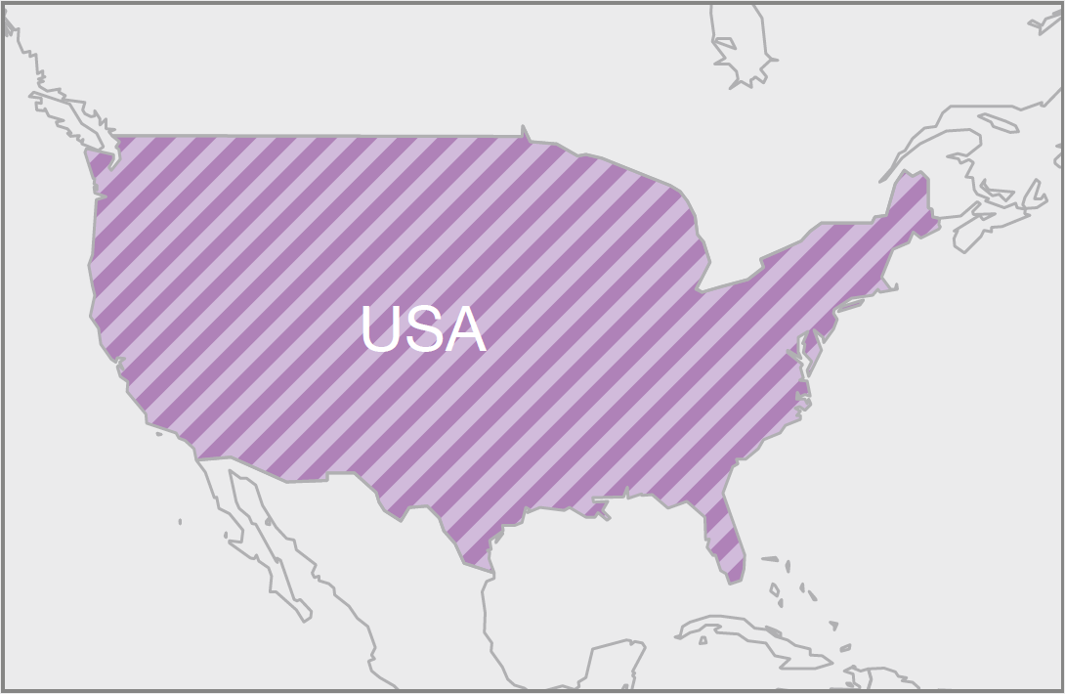
Накратко за нас
SCHWARZ Group
↑ 16
PRODUCTION PLANTS
Kaufland
and Lidl
Lidl
Green cycle
↑ 30
RECYCLING PLANTS
IT center
Production plant
↑ 220
WAREHOUSES
↑ 12 200
STORES

Slide 4
ПЛАН
Преди данните
Сурови данни и ролята на инженера
Инструменти за обработка на данни
На практика
BI, AI & Data Services // Предварителна обработка на данни // 23 Октомври 2021

Slide 5

Преди данните
01
Пенчо Добрев

Slide 6
Преди данните
Разбиране на бизнеса и изискванията
Бизнес:
Съществуващи процеси
Ограничения
Допускания и общоприети факти
Очаквания
Добавена стойност >
Изисквания:
Честота на доставка
Хоризонт
Формат
Брой групи
Други (аз си представях! )
Успех:
Измерване (KPI)
Базова линия (пр. МА)
Подобрения

Slide 7
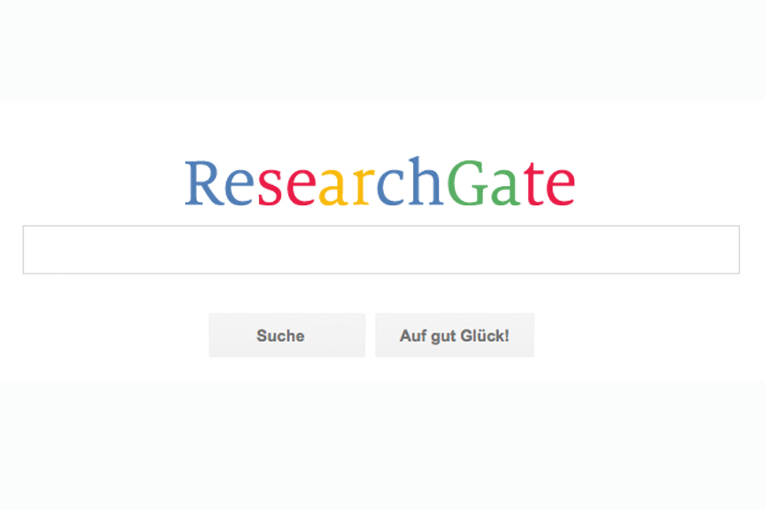
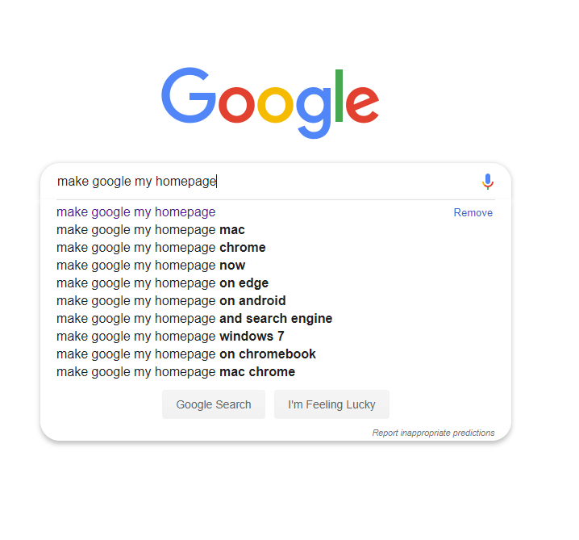
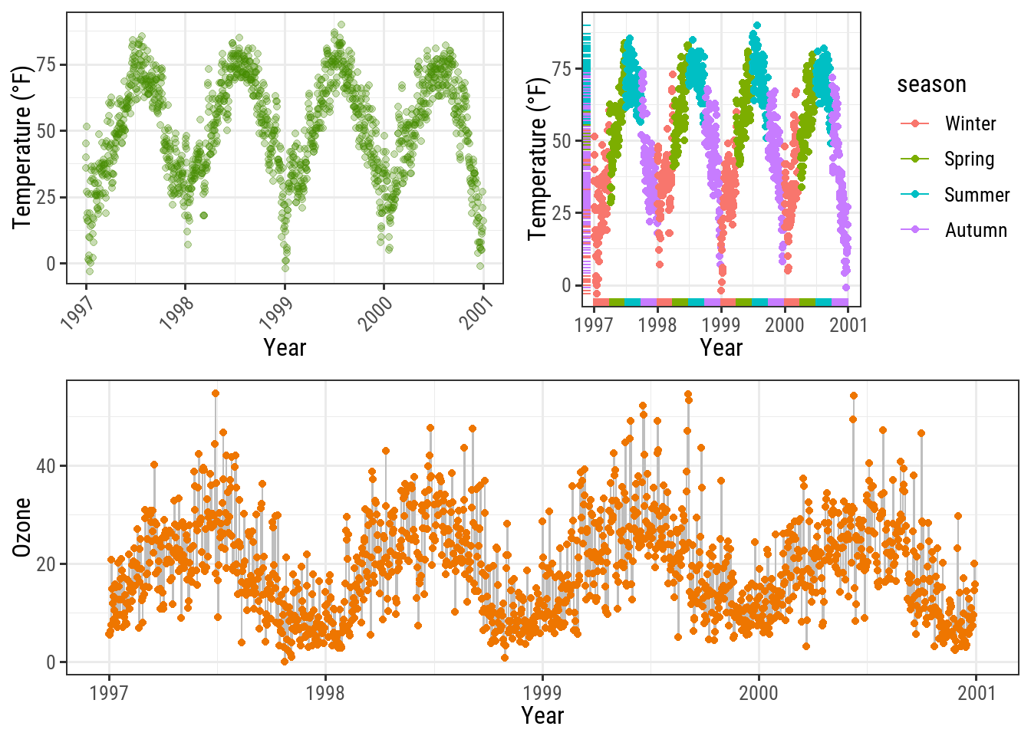
Преди данните
Проучване на възможностите

Slide 8

Сурови данни и ролята на инженера
02
Пенчо Добрев

Slide 9
Сурови данни и ролята на инженера
XML
<Geeks>
<Geek>
<firstName>John</firstName> <lastName>Smith</lastName>
</Geek>
<Geek>
<firstName>Peter</firstName> <lastName>Gregory</lastName>
</Geek>
</Geeks>
JSON
{"Geeks":[
{ "firstName":"John", "lastName":"Smith" },
{ "firstName":"Peter", "lastName":"Gregory" }
]}
CSV
firstName, lastName
Vivek, Kothari
Suraj, Kumar
John, Smith
Peter, Gregory
APACHE AVRO
APACHE PARQUET
….
Notes:
https://en.wikipedia.org/wiki/Comparison_of_data-serialization_formats

Slide 10

Инструменти за обработка на данни
03
Слав Йолов

Slide 11

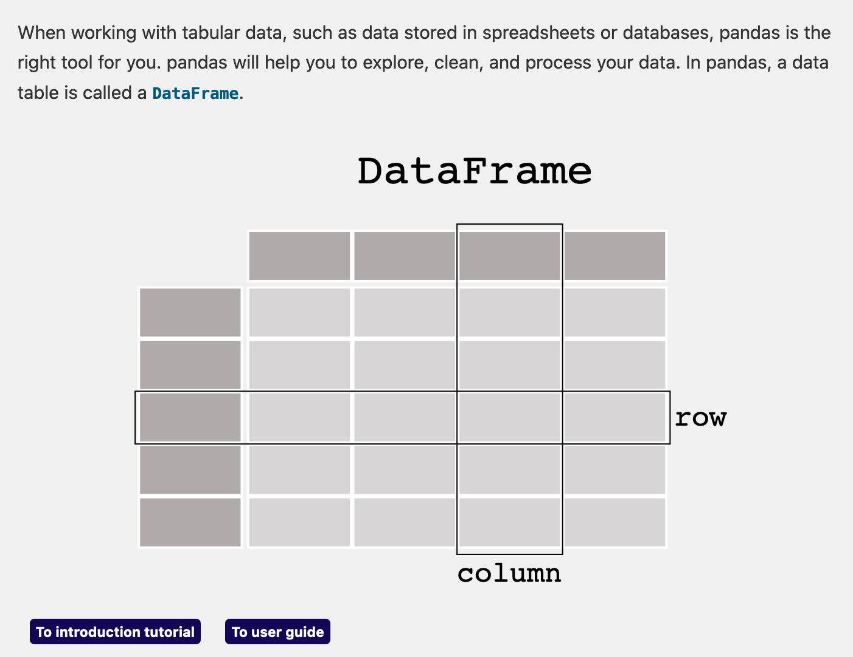
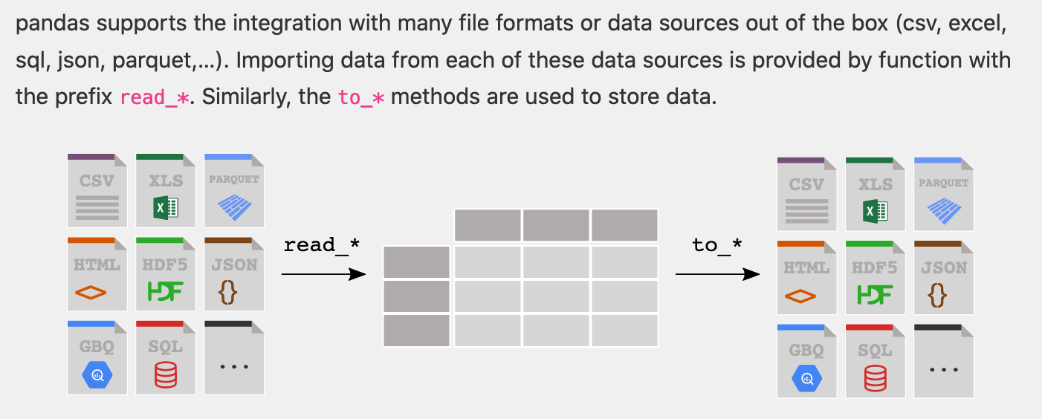
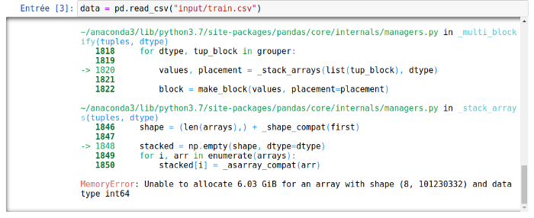
Pandas
pandas is a fast, powerful, flexible and easy to use open source data analysis and manipulation tool, built on top of the Python programming language.
Pandas is must have in the Data Scientist toolkit!
But what if you cannot fit the data in memory ?
Notes:
Resources :
https://pandas.pydata.org/
https://pandas.pydata.org/pandas-docs/version/1.3/user_guide/10min.html
https://www.studytonight.com/pandas/pros-and-cons-of-using-pandas
https://pandas.pydata.org/community/ecosystem.html

Slide 12

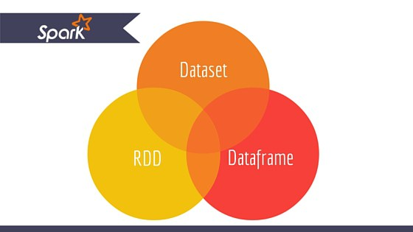
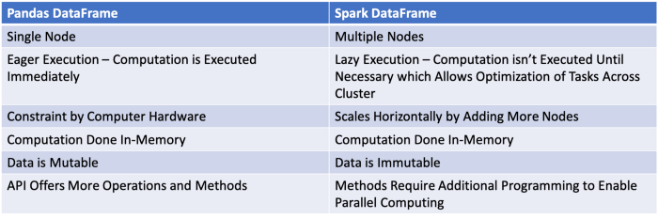


SPARK
Apache Spark™ is a multi-language engine for executing data engineering, data science, and machine learning on single-node machines or clusters.
Apache Spark has become the de facto unified analytics engine for big data processing in a distributed environment.
Comparison of the Pandas and Spark data frames
How Spark works
Notes:
Resources :
https://spark.apache.org/
https://databricks.com/blog/2018/05/03/benchmarking-apache-spark-on-a-single-node-machine.html
https://towardsdatascience.com/parallelize-pandas-dataframe-computations-w-spark-dataframe-bba4c924487c
https://databricks.com/blog/2016/07/14/a-tale-of-three-apache-spark-apis-rdds-dataframes-and-datasets.html
https://data-flair.training/blogs/apache-spark-lazy-evaluation/
https://stackoverflow.com/a/39631185/9962092
https://stackoverflow.com/a/39033308/9962092

Slide 13
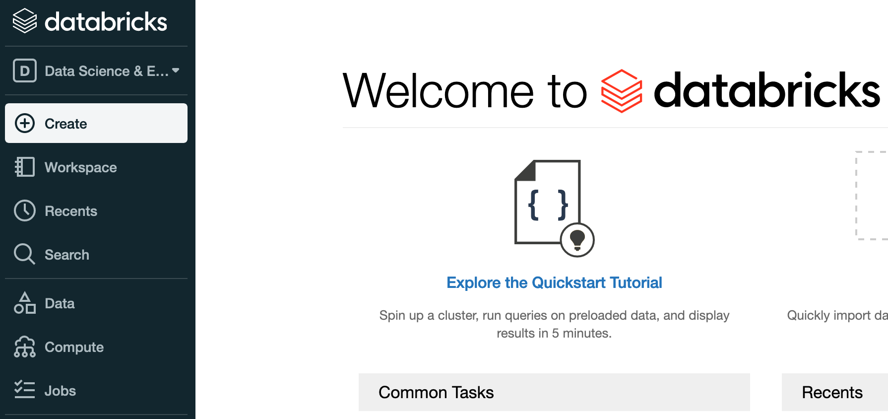
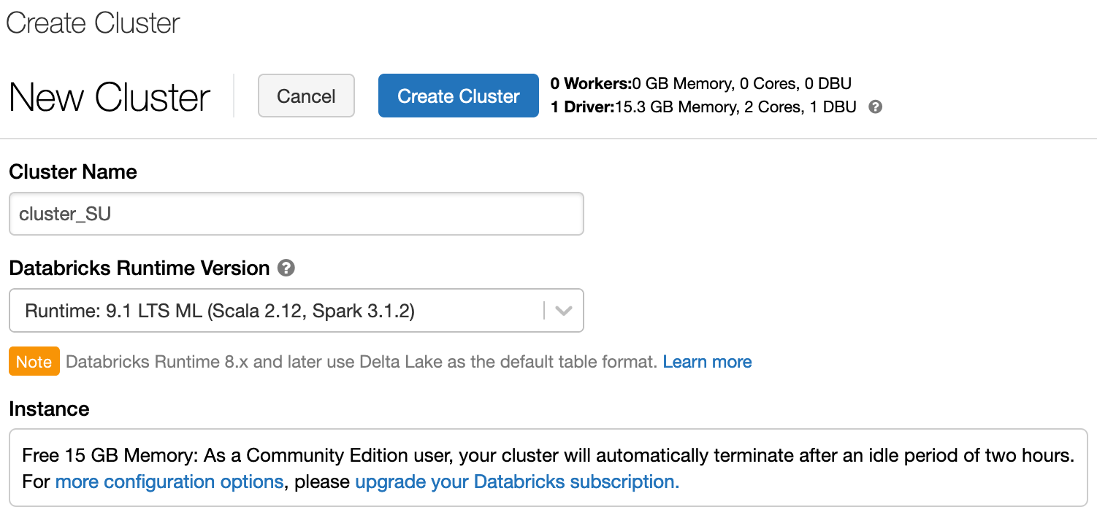
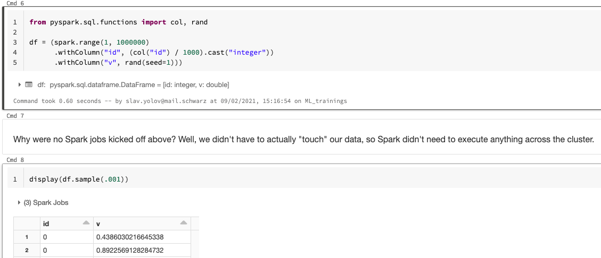

Databricks
Databricks is an enterprise software company founded by the creators of Apache Spark.
The company has also created Delta Lake, MLflow and Koalas, open source projects that span data engineering, data science and machine learning.
Databricks develops a web-based platform for working with Spark, that provides automated cluster management and IPython-style notebooks.
You can try it for free :
Notes:
Resources :
https://www.youtube.com/watch?v=n-yt_3HvkOI
https://en.wikipedia.org/wiki/Databricks
https://databricks.com/
https://databricks.com/product/data-lakehouse
https://community.cloud.databricks.com/login.html
https://databricks.com/product/faq/community-edition

Slide 14
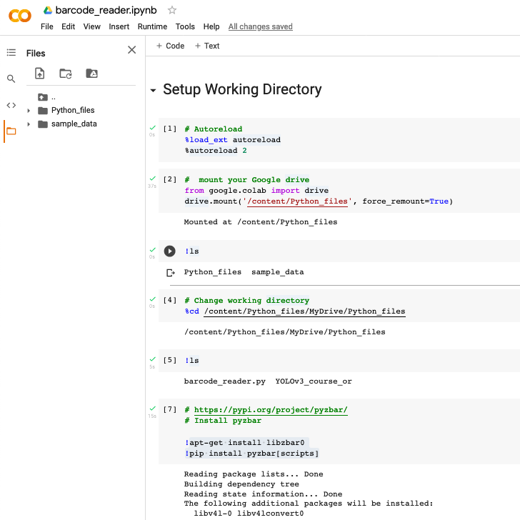
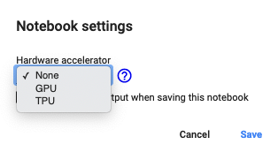
Google colaboratory
Colaboratory, or 'Colab' for short, allows you to write and execute Python in your browser, with
Zero configuration required
Free access to GPUs / TPUs
Easy sharing
Colaboratory is built on top of Jupyter Notebook
Colab notebooks are stored in Google Drive, or can be loaded from GitHub.
Resources in Colab are prioritized for users who have recently used less of them. To get the most out of Colab, consider closing your Colab tabs when you are done with your work, and avoid opting for a GPU when it is not needed for your work.
Notes:
Resources :
https://colab.research.google.com/#scrollTo=5fCEDCU_qrC0
https://research.google.com/colaboratory/faq.html
https://research.google.com/colaboratory/faq.html#resource-limits
https://www.youtube.com/watch?v=inN8seMm7UI
https://www.youtube.com/watch?v=RLYoEyIHL6A

Slide 15
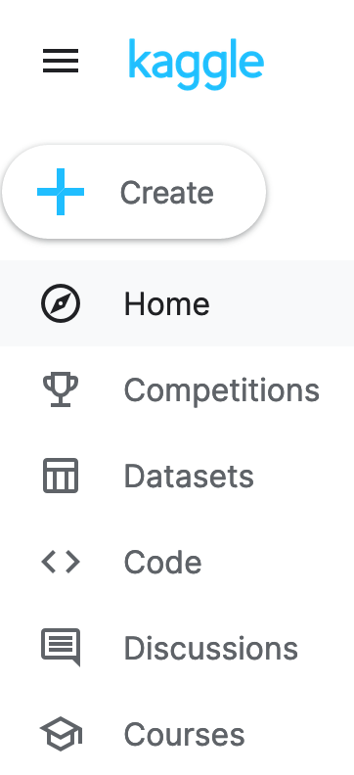
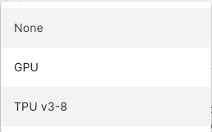
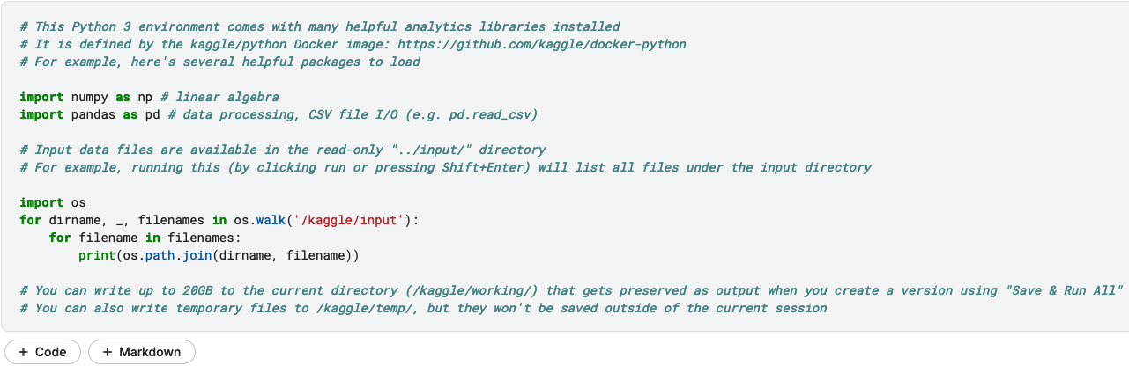
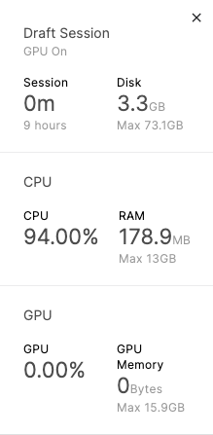
KAGGLE
Kaggle, a subsidiary of Google LLC, is an online community of data scientists and machine learning practitioners.
Kaggle allows users to find and publish data sets, explore and build models in a web-based data-science environment, work with other data scientists and machine learning engineers, and enter competitions to solve data science challenges.
Visit the code section to explore and learn
Supported accelerators
Or create your own notebook
Notes:
Resources :
https://en.wikipedia.org/wiki/Kaggle
https://www.kaggle.com/docs/notebooks
https://www.kaggle.com/learn
https://www.kaggle.com/datasets
https://www.kaggle.com/code
https://www.kaggle.com/competitions
https://www.kaggle.com/general/108481
https://www.kaggle.com/page/GPU-tips-and-tricks
https://www.kaggle.com/docs/tpu

Slide 16

На практика
04
Недялко Йорданов

